Slide 1


The Triple-X-program has recruited you to come for testing at (www.github.com/Triple-X-Program)

Slide 2
CONGRATULATIONS !
You are finally recruited.

Slide 3
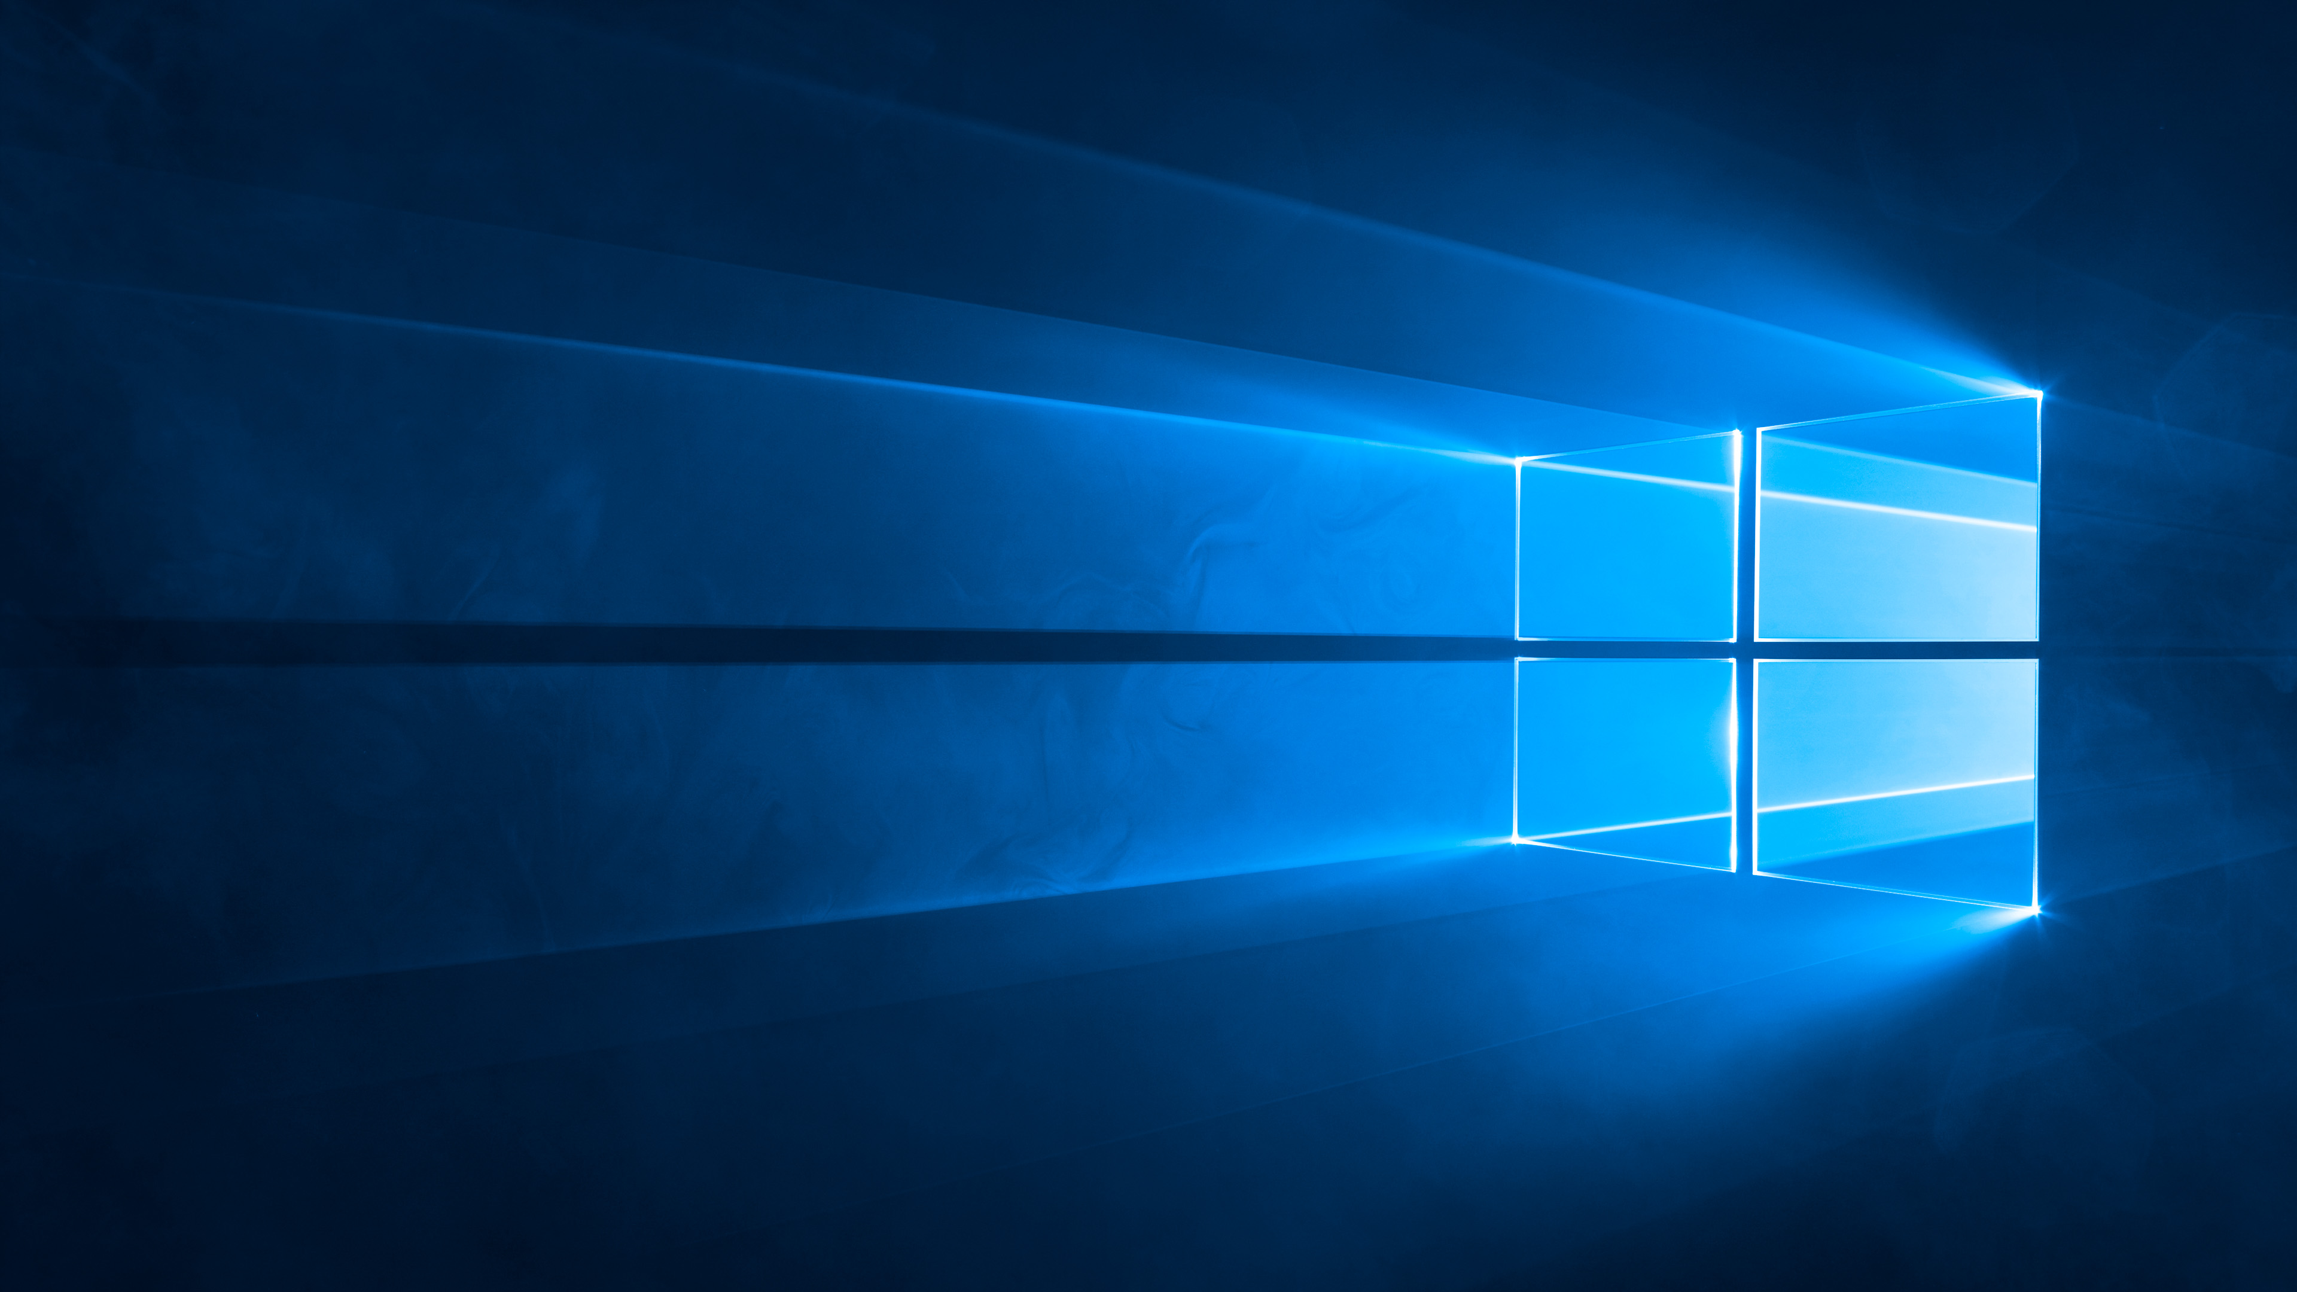

Your Device might not be an
Raspberry Pi
You need to be on that

Slide 4

You need wor-flasher on your pi so
That you can get windows
Or
If you have Microsoft Windows 11/10
Are the allowed OS’s in triple x

Slide 5

We request that you as a recruit
Must have
Visual Studio Code
Installed. Me as your supervisor
Should not have it installed but you
Have to get it

Slide 6

Please scan this QR code→

Slide 7
WELCOME!
To Triple X

